Slide 1
R and the outside world
Ed Wolfrum
March 20, 2012

Slide 2
The goals of this talk are to….
show how R can be used to
  query databases
  connect with Twitter & GoogleMaps
Learn LibreOffice Impress
Not look too stupid

Slide 3
I will show 3 examples
R and databases
  RODBC
  RMySQL
R and Twitter
  twitteR
  RCurl
R and GoogleMaps
  RgoogleMaps

Slide 4
Getting Data into R
Methods I use often
read.table(file=…)
read.csv(file=…)
read.xlsx (from the xlsx package)
These work across the web
theFile="http://personality-project.org/r/datasets/R.appendix3.data"
theData=read.table(theFile,header=T)
These are good for smallish datasets, but it would be useful to read in real databases

Slide 5
Database Connectivity
2 general approaches
  RODBC
  RMySQL
What do I need?
  A running database server (e.g., mysql, postgresql)
  ODBC data service (for RODBC) or libmysqlclient.* (for RMySQL)
  RODBC or RMySQL package

Slide 6
RODBC vs. RMySQL
Two packages for accessing SQL databases
ROBDC is essentially a wrapper for ODBC (open database connectivity)
  Needs ODBC service installed
RMySQL comes from the DBI (Database Interface) family
  RMySQL, RPostgreSQL, ROracle, RSQLite
  RmySQL uses the libmysqlclient from the MySQL installation
I couldn’t get RMySQL package installed because you need to compile DBI packages from source….

Slide 7
R talking to mySQL using RODBC
Download & Install mySQL
  Getting the daemon mysqld to run as a service has been tricky for me at work; no admin rights on my PC
Download & install the ODBC driver
  Note that to get the 32-bit mySQL ODBC driver working in Windows 7, you CAN’T USE the service GUI (insert Mac/Linux praise here)
Download & install the RODBC package

Slide 8
RODBC EXAMPLE

Slide 9
TwitteR
Uses Rcurl package, which handles HTTP & FTP requests
This package kind of begs the question “why would you care about Twitter”. This issue is outside the scope of my talk.

Slide 10
TwitteR Example
This is based on Jeffrey Breen’s prize-winning example of assessing airline consumer sentiment by analyzing Twitter feed data using an 'opinion lexicon'
http://www.inside-r.org/howto/mining-twitter-airline-consumer-sentiment
https://github.com/jeffreybreen/twitter-sentiment-analysis-tutorial-201107

Slide 11
Putting this to work
QUESTION:
Do people like renewable energy or fossil energy more?
PROCEDURE:
collect some Tweets
get the text part of the Tweets
strip out the control characters
grade them as positive/negative
summarize the results

Slide 12
TwitteR EXAMPLE

Slide 13
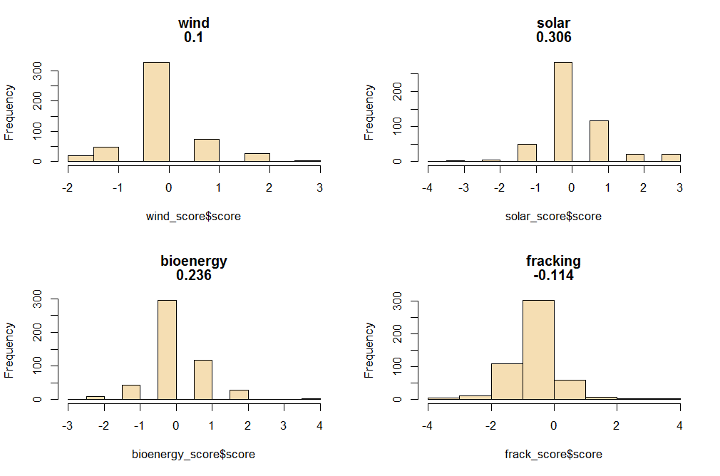
Results – Popularity of Different Energy Sources

Slide 14
RGoogleMaps
a wrapper for the GoogleMaps API
Useful for grabbing static maps and then annotating them
3 steps
  Standardize addresses
  Geocoding – convert addresses into lat/long coordinates
  Get a map from Google
Free address standardization correction

Slide 15
RGoogleMaps
a wrapper for the GoogleMaps API
Useful for grabbing static maps and then annotating them
3 steps
  Standardize addresses
  Geocoding – convert addresses into lat/long coordinates
  Get a map from Google
Free address standardization correction

Slide 16
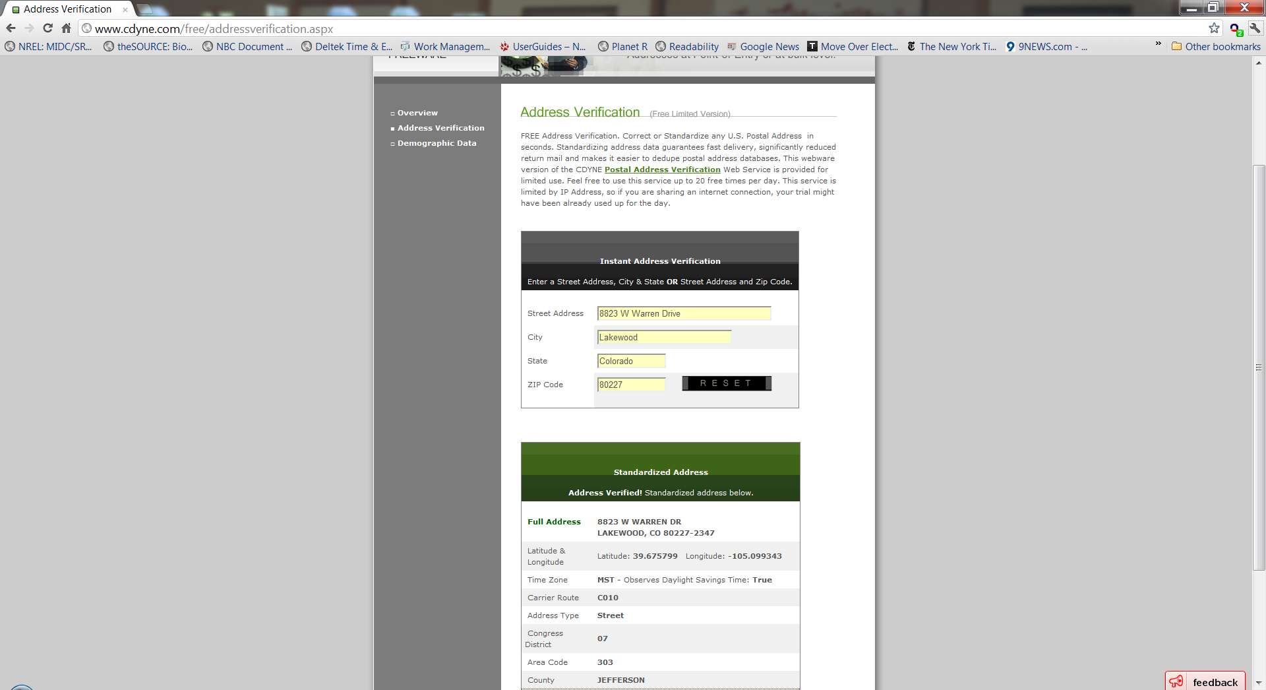
Standardization & Geocoding all in one step www.cdyne.com
There are some free sites that give out a limited # of standardizations and geocodings per day

Slide 17
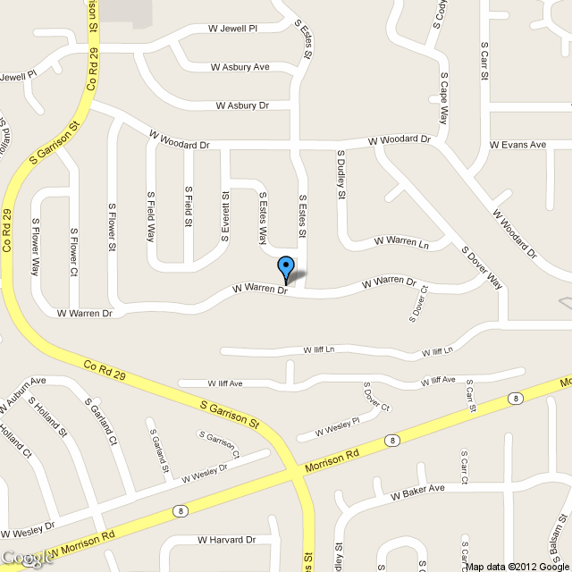
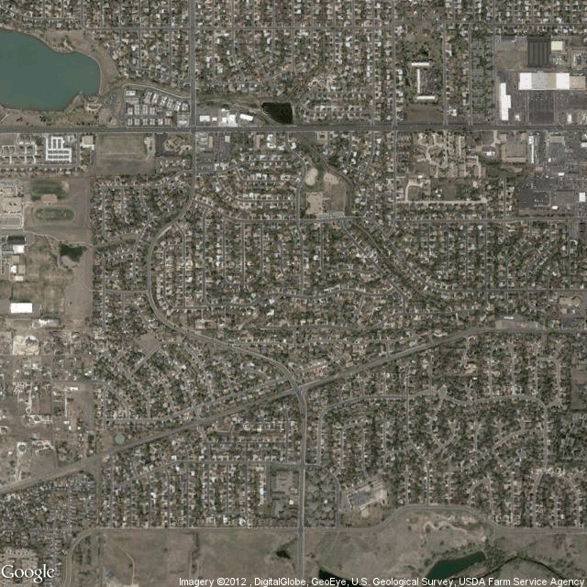
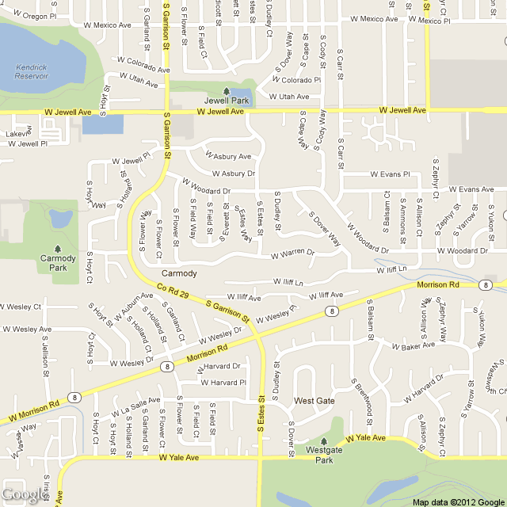
Ed's Neighborhood
theLatlong<-c(39.676247541279,-105.0955752856)
theSize<-c(640,640)
theZoom<-15
theFile<-paste("map",theZoom,".png")
j<-getMap(theLatlong,zoom=theZoom,destfile=theFile,
sensor="false", size=theSize,format="png", maptype="roadmap",RETURNIMAGE = FALSE, GRAYSCALE = FALSE)

Slide 19
R tip of the month (RTOTM)
Lining up legends & symbols
plot(tD$x,tD$y, pch=19,col=tD$type,main="RTOTM-Legends")
theColors <-palette()[unique(tD$type)]
# two ways to define legend; both “work”, but give different results
#
theL_RIGHT <-as.character(unique(tD$type))
theL_WRONG <-as.character(levels(tD$type))
legend(.04,.07,legend=theL_RIGHT,pch=19,col=theColors,title="RIGHT")
legend(.14,.07,legend=theL_WRONG,pch=19, col=theColors, title="WRONG")
text(.20,.075, labels="unique() gives order of use-RIGHT")
text(.20,.072, labels="levels() gives alpha order-WRONG")
unique() gives levels of a factor in USE ORDER; corresponds with col= in plot()
levels() gives levels of a factor in ALPHABETICAL ORDER; not related to col= in plot()

